Slide 1
NURSE PRACTITIONER (NP) STUDENT CLINICAL ORIENTATION
Walden University
Nurse practitioner program
AGACNP
AGPCNP
FNP
PMHNP

Slide 2
Welcome
This power point will discuss highlights of our clinical courses and will provide a quick access guide , with classroom requirements and reminders.
Dr. Jennifer Stone – Clinical Supervisor, jennifer.stone2@mail.waldenu.edu
Dr. Tara Harris – PT Clinical Supervisor, tara.harris4@mail.waldenu.edu

Slide 3
Welcome to NP Program
Dr. Linda Steele – NP Program Director
Dr. Timothy Legg – PMHNP Coordinator
Dr. Salma Hernandez – AGACNP & AGPCNP Coordinator
Dr. Phyllis Morgan – FNP Coordinator
Dr. Stefanie Gatica – FNP Coordinator
Dr. Jennifer Stone – Clinical Supervisor
Dr. Tara Harris - Clinical Supervisor

Slide 4
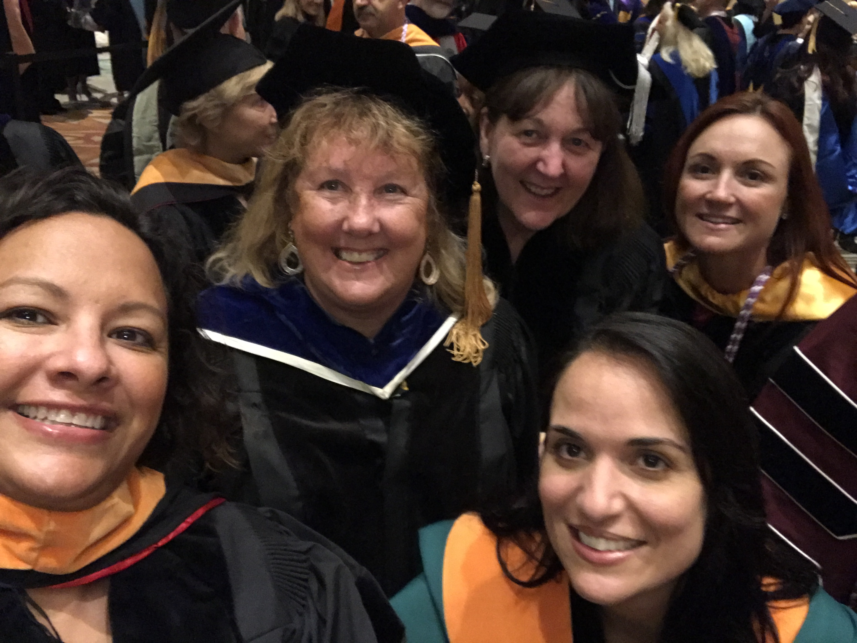
NP Full time faculty
Dr. Rachel Carlton
Dr. Eva Hvingelby
Dr. Mahaman Moussa
Dr. Erica Sciarra
Dr. Jeani Thomas
Dr. Cindy Trent
Dr. Gretchen Zunkel

Slide 5
Chain of Command and Course Coordinator Support
Any questions or concerns about your clinical course:
First point of contact is the Clinical faculty
Didactic faculty – clinical faculty will contact if help is needed.
Lead faculty – didactic faculty will contact if help is needed.
Course coordinator – lead faculty will contact if help is needed
Clinical Supervisors – faculty will contact for specific clinical issues or questions
Course Coordinators
Timothy Legg – 6512, 6630, 6640
Salma Hernandez – 6501, 6540, 6550, 6560
Phyllis Morgan – 6521, 6551, 6565
Stefanie Gatica – 6531, 6541

Slide 6
Student resources
Student Assistance Program - Students, and anyone in their households, who want to use this service or are referred for assistance should be encouraged to call 1-866-465-8942 (TDD: 1-800-697-0353) or visit http://inside.WaldenU.edu/sap for more information. When students request services from the program, they will be asked for a Walden ID. That ID is SAP4EDU.
Writing Center - http://academicguides.waldenu.edu/writingcenter/home
Walden library - http://academicguides.waldenu.edu/library
Technical support – 800-925-3368

Slide 7
PRE-CLINICAL INFORMATION
Students are to create a schedule for clinical hours that the student and preceptor have agreed upon and email it to your clinical faculty
Please save it in a calendar format and include your contact information as well as preceptor’s contact information on the schedule
Save the file name and “clinical schedule”
You must email the schedule to Clinical Faculty
Clinical faculty will call or email student and preceptor to set up a minimum of 1 phone conference and 2 email contacts during the quarter

Slide 8
PRECLINICAL INFORMATION FOR STUDENTS
You should reflect and prepare learning goals and objectives for the course
Review the course objectives
Review SOAP notes article
Review the preceptor evaluation of student
Review the Competencies for your specialty (AGACNP, AGPCNP, FNP, PMHNP) by visiting the following sites:
Core Competencies for nurse practitioners http://nonpf.com/associations/10789/files/NPCoreCompetenciesFinal2012.pdf
AGPCNP Competencies http://nonpf.com/associations/10789/files/Adult-GeroPCComps2010.pdf
FNP Competencies http://www.nonpf.org/associations/10789/files/PopulationFocusNPComps2013.pdf
AGACNP Competencies http://www.aacn.nche.edu/geriatric-nursing/Adult-Gero-ACNP-Competencies.pdf
PMHNP Competencies: http://www.aacn.nche.edu/education-resources/PopulationFocusNPComps2013.pdf

Slide 9
CLINICAL ATTIRE
STUDENTS MUST WEAR APPROPRIATE ATTIRE
Appropriate | Inappropriate
Comfortable and practical | Clothing that is distracting or offensive to others
Lab Coat with name tag | Clothing with words, terms or pictures that may be offensive to others
Pressed and clean | Clothing that works for the beach, yard work, dance clubs, exercise sessions
Fashion brand names on clothing | Clothing that reveals too much cleavage, your back, your chest, your stomach or your underwear
Professional appearance | Torn, dirty or frayed clothing
Closed-toe shoes | Jeans
Clean nails

Slide 10
Name Tag
Instructions for making your name tag
Students go to myWalden Portal
Welcome Center tab
Get Prepared tab
Scroll to bottom of page #7
Print ID badge
If your clinical site requires a photo ID, please add a passport photo (scan your photo with name tag)

Slide 11
Resources STUDENTS should take to CLINICAL
Practice guidelines for your specialty program: FNP, AGACNP, AGPCNP, and PMHNP
Ask preceptor if acceptable to use smartphones, etc. while in the setting
Pharmacology applications on your smartphone or iPad, etc.
Ask preceptor what resources they use most often

Slide 12
STUDENT Expectations
Print the Syllabus for the Course and hand deliver to your preceptor and review the objectives for the course
Students should see the minimum number of patients outlined in this presentation.
Generally you should:
Ask the patient if they mind if you see them in combination with your preceptor
Perform your assessment: Subjective, Objective Data
Make a list of differential diagnoses
Form a tentative plan of care – look for teaching opportunities – look for evidence to back your plan
Consult with your preceptor and revise your assessment, diagnoses and plan

Slide 13
STUDENTS First Day
Students should be oriented to the clinical site by preceptor or office personnel for a maximum of 8 hours
The lay out of the office
Office procedures
Lunch
Restroom locations
Other
Orientation/observation to the site

Slide 14
**NEW **Requirements for patient encounters per course
Consensus of patient numbers by course. These are MINIMUM numbers of patients:
NURS 6531 – 144 patients in 144 hours
NURS 6540 – 100 patients in 144 hours
NURS 6541 – 144 patients in 144 hours
NURS 6550 – 75 patients in 144 hours
NURS 6551 – 100 GYN patients; 25 OB patients in 144 required hours
NURS 6560 – 75 patients in 144 hours
NURS 6565 – 144 patients in 144 hours
PMHNP Courses: NURS 6640, NURS 6650, NURS 6660, NURS 6670:
“Students in the PMHNP program will need to complete 144 hours of practicum in EACH of the four practicum courses. It is acknowledged that a variety of factors will influence the number of clients seen, but students should strive to see as many clients possible each clinical day.”
*A minimum of 144 clinical hours are required in each practicum course. More hours can be completed but cannot transfer to another clinical course.

Slide 15
Meditrek
Students are to upload their information on the time log and patients log every 48 hours.
Midterm and final evals by preceptor need to be completed in Meditrek.
Midterm eval should be completed prior to midterm conference call, then reviewed.
Didactic faculty are responsible to ensure ALL clinical students have their time logs signed and final evals completed prior to entering final grade.

Slide 16
Meditrek Contact Information
If the preceptor does not receive an email with login information, the student or the preceptor should email the preceptor’s name and email, along with the student’s name and Walden ID number to SONPreceptor@waldenu.edu and the login information will be sent to the preceptor directly.

Slide 17
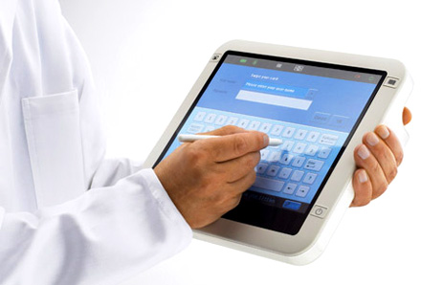
How do STUDENTS document patient encounters at clinical site?
This will be up to the preceptor and clinical faculty
It is a good idea to learn from each site as many have electronic medical records
The preceptor may want you to hand write your SOAP note

Slide 18
Documenting Clinical Experiences for the Course
To prepare for this course’s Practicum Experience, address the following in Practicum Journal (AGPCNP and FNP students ONLY):
Select and describe a nursing theory to guide your practice.
Develop goals and objectives for your Practicum Experience in this course. When developing r goals and objectives, students are to be sure to keep the competency domains of practice in mind.
Create a timeline of practicum activities based on your practicum requirements.

Slide 19
Documenting Clinical Experiences for the Course
All patients must be entered on the NP Patient Log within 48 hours of each clinic day.
All clinic hours must be entered on the Time log within 48 hours of each clinic day.
Clinical faculty will review all NP patient logs and Time logs periodically throughout the course. Students are to keep them up-to-date at all times.
Weekly Journal Entries are required but only submitted Weeks 3, 7 and 10 (or as directed in clinical course).

Slide 20
Grading CLINICAL JOURNALS and Time Logs
For the Journal Entries and Practicum Time Logs—which are assessed with a Satisfactory (S) or Unsatisfactory (U) score—the numerical grade will show as 0 points and the “S” or “U” will be posted in the Feedback area by your Instructor. These scores of 0 points do not affect your grade; they simply allow for a placeholder to place the “S” or “U” scoring. *All journal entries must be done and graded satisfactorily before a passing grade in clinical can be achieved.

Slide 21
Midterm and Final Evaluations
All students are required to have their preceptor complete a midterm and final evaluation in order to pass the course
Midterm evaluation is done through Meditrek and should be completed by the preceptor during weeks 4-6; the preceptor will receive login credentials to Meditrek beginning in week 3.
Students must have a satisfactory final evaluation by preceptor in Meditrek by end of week 10.
All students are required to have their preceptor and practicum site evaluation in Meditrek by end of week 10.

Slide 22
What happens if…
Student or preceptor is ill or has an emergency
Students are to notify their clinical faculty and make plans to obtain the missed hours
If student is ill, please make sure you notify your preceptor
If student and/or preceptor terminate the agreement
Students are to notify clinical faculty immediately and be proactive in securing another preceptor

Slide 23
Clinical Failure
Behaviors constituting clinical failure include, however are not limited to, the following:
Demonstration of unsafe performance and/or decision-making skills.
Failure to complete clinically related class assignments and/or clinical log.
Failure to complete the required clinical hours and patients numbers
Falsification of clinical hours, records, or documentation.
Failure to complete clinical hours with approved preceptor. All preceptors must be approved or clinical hours will not count.

Slide 24
Students Must Remember…
Students are a guest in the clinical setting and should act politely at all times
Students are not make personal phone calls. Turn your phones on vibrate and take calls only during breaks
Always thank the patient and preceptor and office staff
Be active in the learning process
You are there to learn to be a health care provider. You are not a nurse in the clinic.
It is ok to be wrong. We expect that as part of the learning process.
Ask questions!

Slide 25
IF YOU DON’T KNOW…
Ask preceptor
Ask clinical faculty
Ask didactic faculty
We all want students to learn and be successful

Slide 26
Specialty Coordinators
Dr. Salma Hernandez AGACNP and AGPCNP salma.hernandez@mail. waldenu.edu
Dr. Phyllis Morgan FNP phyllis.morgan@mail.waldenu.edu
Dr. Stefanie Gatica FNP stefanie.gatica@mail.waldenu.edu
Dr. Timothy Legg Coordinator PMHNP timothy.legg@mail.waldenu.edu

Slide 27
Clinical Supervisors
Dr. Jennifer Stone – Full time Clinical Supervisor for FNP, AGACNP, AGPCNP, PMHNP
jennifer.stone2@mail.waldenu.edu
Dr. Tara Harris – Part time Clinical Supervisor for FNP, AGACNP, AGPCNP, PMHNP
tara.harris4@mail.waldenu.edu

Slide 28
Field Office Contacts
Preceptors – sonpreceptor@mail.waldenu.edu
Field Sites for Affiliation Agreements – sonaffiliation@mail.waldenu.edu
Students - nursefieldtraining@mailwaldenu.edu
Onboarding Questions – sononboarding@mail.waldenu.edu

Slide 29
THANK YOU! MUCH SUCCESS!

